Slide 1

“It’s the refs fault!”

Slide 2

Why should we care?

Slide 3
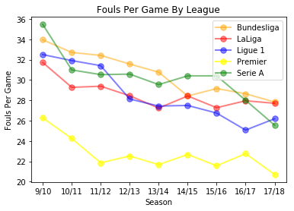

Slide 4
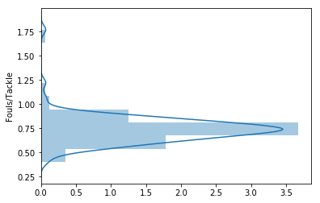
Season 17/18 distribution
What does this mean?
Majority of Refs call a foul 7.5 out 10 tackles
- Refs are quick to call a foul

Slide 5
To add more context
Average Time Without a Foul Across All Leagues and Seasons = 3.2 minutes
Average Time Without a Foul Across All Leagues, During 17/18 Season = 3.47 min

Slide 6
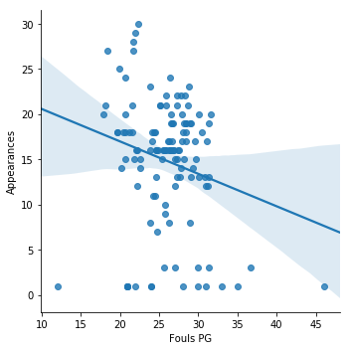
correlation between fouls per game and appearances during 2017/18 Season

Slide 7
What does this show?
Referees are quick to call a foul, meaning less playing time and opportunities to score.
Referees are humans and implement the rules based on their interpretation.
Being on the good side of the referee could be in our favor, meaning more playing time between fouls.
Soccer training model could change.
If a foul occurs every 3-4 minutes with 10-40 seconds of rest, then training could mimic that.

Slide 8
Next steps
Identify which referee will be officiating the game my team will be participating in.
Knowing the ref means I’ll be aware of what to potentially expect from the game.
Adjust training to incorporate 4-5 minutes of high intense training with 10-40 seconds of rest.

Slide 9
If I had more time
Name | Appearances | Home Win % | Away Win % | Draw %
Michael Oliver | 30 | 30 | 36.7 | 33.3
Jonathan Moss | 29 | 27.6 | 37.9 | 34.5
Martin Atkinson | 28 | 35.7 | 39.3 | 25
Anthony Taylor | 27 | 44.4 | 22.2 | 33.3
Andre Marriner | 27 | 51.9 | 37 | 11.1
Mike Dean | 25 | 44 | 28 | 28
Craig Pawson | 24 | 62.5 | 20.8 | 16.7
Kevin Friend | 21 | 66.7 | 9.5 | 23.8
Neil Swarbrick | 20 | 55 | 30 | 15
Graham Scott | 20 | 55 | 30 | 15

